Slide 1
Reinforcement Learning for Personalization in EdTech
Amir Ali Soltani & Amir Hussain Birjandi

Slide 2
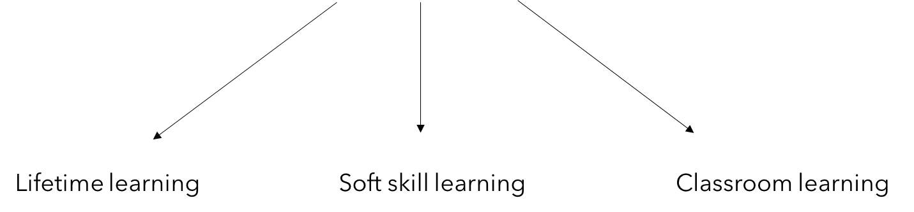
Edtech
Edtech, or education technology, is the practice of introducing information and communication technology tools into the classroom to create more engaging, inclusive and individualized learning experiences.

Slide 3




Why Google, Apple and Microsoft are battling for Education?

Slide 4
Learning Content Recommender

Slide 5
Part1: Learning Content Recommender
4 Groups:
Primary School Students
High School Students
University Students
Middle Age Learner
4 Contents:
Group Class
Video
Private Class
PowerPoint

Slide 6
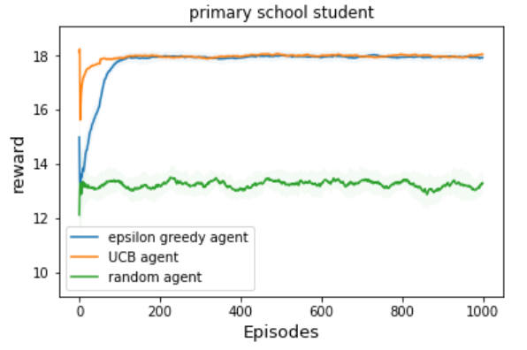
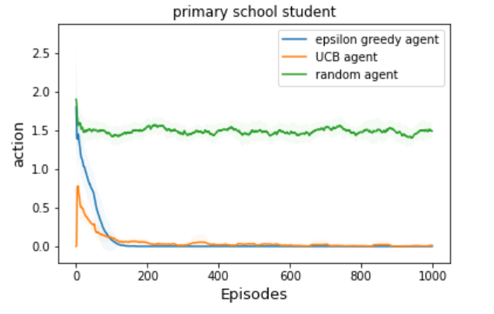
Part1: Learning Content Recommender
Primary School Student
Group Class ~ N(11,1) - Video ~ N(3,1) - Private Class ~ N(10,1) - Powerpoint ~ N(1,1)
action:
0
1
2
3

Slide 7

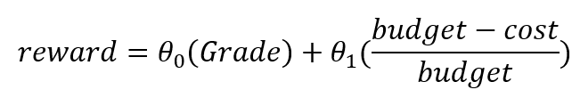
Part2: Personalized Learning Content Recommender

Slide 8
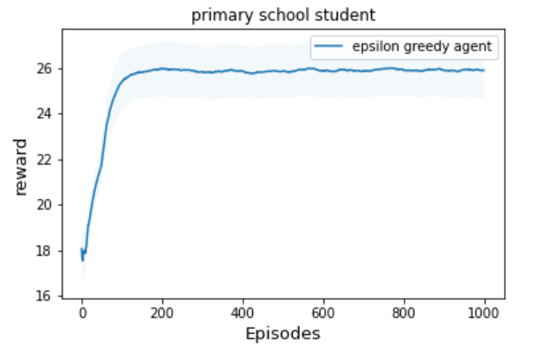
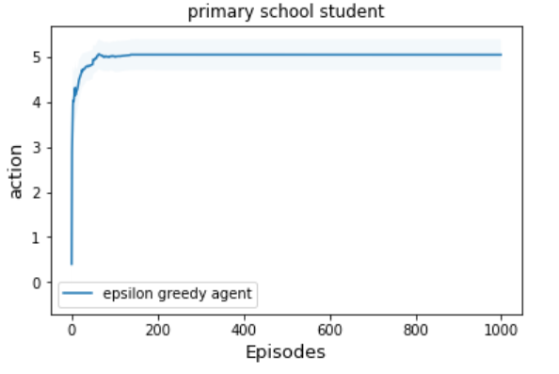
Part2: Personalized Learning Content Recommender
Primary School Student , theta = [1,0] , budget = 200

Slide 9
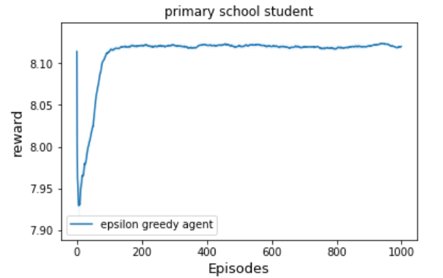
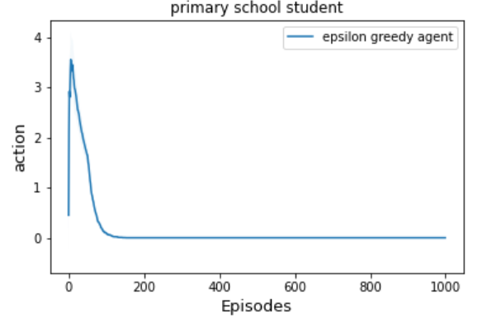
Part2: Personalized Learning Content Recommender
Primary School Student , theta = [0.15,0.85] , budget = 100

Slide 10
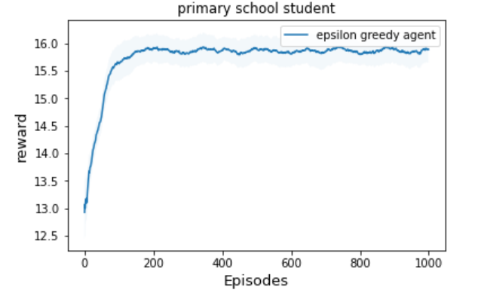
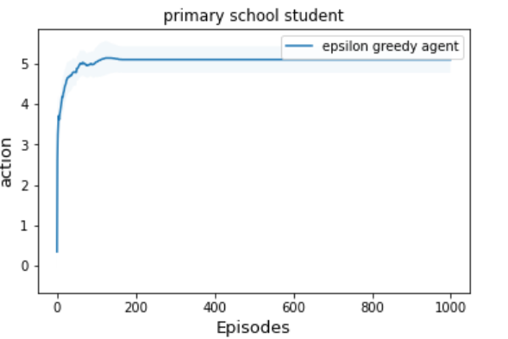
Part2: Personalized Learning Content Recommender
High School Student , theta = [0.6,0.4] , budget = 200

Slide 11
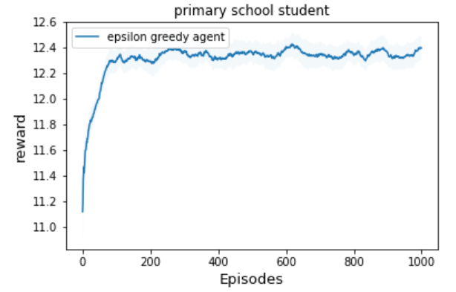
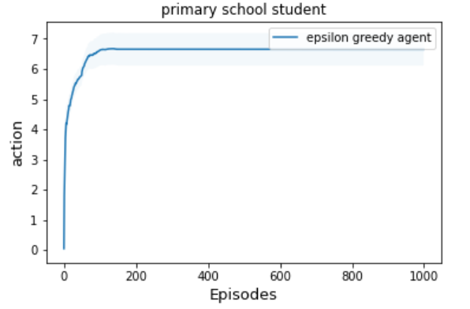
Part2: Personalized Learning Content Recommender
University Student , theta = [0.5,0.5] , budget = 80

Slide 12
Feature-Based Contexualize Recommender

Slide 13
Idea & Data
Basic features can affect learning model
Introducing some packages
Creating dataset
Fixed features
School type, gender, age, IQ, EQ, …
Inconsistent features
School time, free time, package usage time, package model

Slide 14

Reward Engineering
Feature reward calculation
Educational reward
Emotional reward
Package rewards
Total reward calculation and normalization

Slide 15
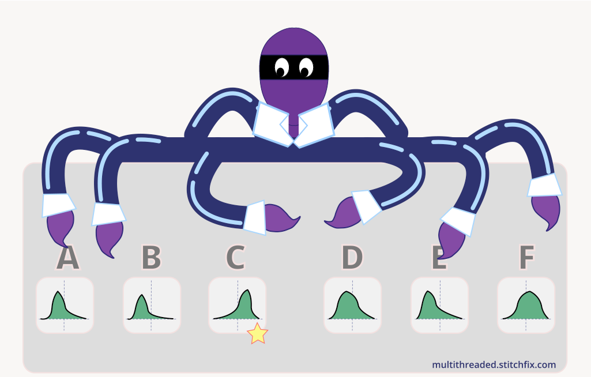
Method
Epsilon-greedy for armed-bandit model
Actions are packages!
How can package time change learning style?
Utility!

Slide 16
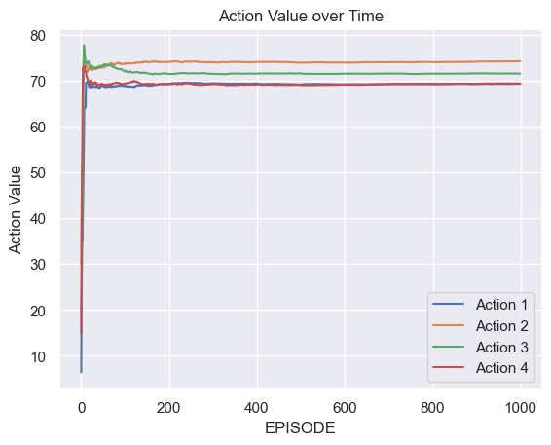
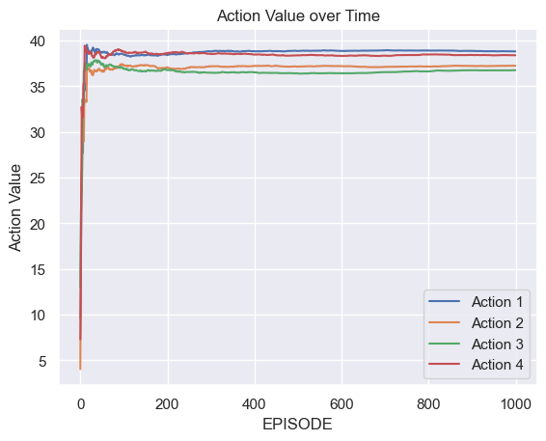
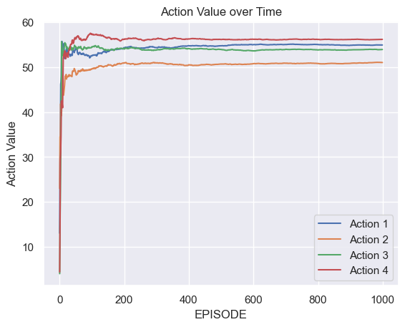
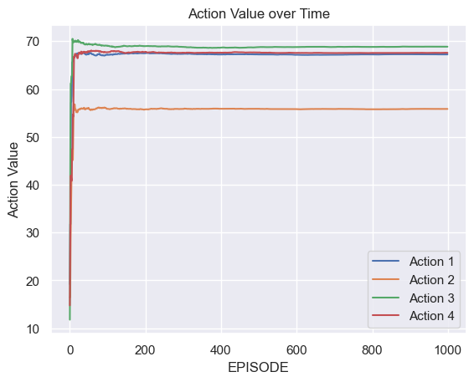
Results based on utility
Prob = 1
Prob = 0.8
Prob = 0.7
Prob = 0.5

Slide 17
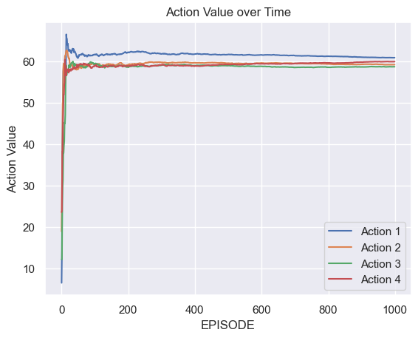
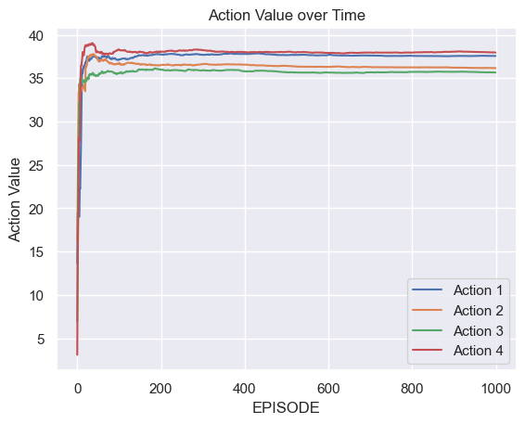
Results based on feature set

Slide 18
References
Reinforcement Learning in Education: A Multi-Armed Bandit Approach
Student Intervention System using Machine Learning Techniques

